Slide 1
Design

Slide 2
Software Design
Software design is a splendored thing… it is a creative activity with many different aspects
We first look at the design phase in general and then examine function-oriented design as manifested by
structure charts and
the structured design approach
Tabular design

Slide 3
Software Design
In software design, we create a solution (or solutions) to the problems identified by the software requirements phase.
Software design is a process to transform user requirements into some suitable form, which helps the programmer in software coding and implementation.
Design typically consists of a “high-level” phase and a “low-level” phase
Function-oriented design views a system as a set of modules with clearly defined behavior that interact with each other in a clearly defined manner to meet the system's requirements

Slide 4
Design Methodologies
There are many different ways to create a design: design methodologies aim to reduce the search space
A design methodology is a systematic approach to creating a design by applying a particular set of techniques and following a particular set of guidelines.
The rules and techniques of a design methodology are often “loose”: they do not attempt to reduce design to a sequence of mechanical steps
Notes:
The rules and techniques of a design methodology are often “loose”: they do not attempt to reduce design to a sequence of mechanical steps
After all, design is primarily a creative activity
There will not be a single correct solution to a given set of requirements

Slide 5
Design Objectives
The goal of software design is to find the best possible design that meets your needs
You may have to explore different designs
Unfortunately, evaluation criteria for a design are often subjective and non-quantifiable
Major criteria to evaluate a design
Correctness
Efficiency
Maintainability
Cost
Notes:
Major criteria to evaluate a design
Correctness
A software design is correct if a system built precisely according to the design satisfies the requirements of the system
A design should be verifiable (does an implementation match the design), complete (does the design address its specified requirements) and traceable (all design elements can be traced back to specific requirements)
Efficiency
Does the design efficiently make use of scarce resources
Maintainability
How easy is it for the design of a system to be understood?
Simpler designs make it easy for a developer to understand and then maintain the system
Cost
Does the design help to reduce costs in later phases of software development?
Can one design achieve the same quality as another design while reducing costs?

Slide 6
Design Principles
Problem Partitioning and Hierarchy
Abstraction
Modularity

Slide 7
Problem Partitioning and Hierarchy
Separation of concerns/ Problem Partitioning is a design concept that suggests that any complex problem can be more easily handled if it is subdivided into pieces that can each be solved and/or optimized independently.
By separating concerns into smaller, and therefore more manageable pieces, a problem takes less effort and time to solve.

Slide 8
Problem Partitioning and Hierarchy
It follows that the perceived complexity of two problems when they are combined is often greater than the sum of the perceived complexity when each is taken separately.
This leads to a divide-and-conquer strategy—it’s easier to solve a complex problem when you break it into manageable pieces.

Slide 9
Abstraction
It is a tool that permits a developer to consider a component in terms of the services it provides without worrying about the details of its implementation.
Abstraction is an excellent tool for creating a hierarchical understanding of a system's functionality.
In design contexts, you might see references to two “types” of abstraction

Slide 10
Abstraction
PROCEDURAL ABSTRACTION refers to a sequence of instructions that have a specific and limited function.
The name of a procedural abstraction implies these functions, but specific details are suppressed.
An example of a procedural abstraction would be the word open for a door.
Open implies a long sequence of procedural steps (e.g., walk to the door, reach out and grasp knob, turn knob and pull door, step away from moving door, etc.).

Slide 11
Abstraction
DATA ABSTRACTION is a named collection of data that describes a data object.
In the context of the procedural abstraction open, we can define a data abstraction called door.
Like any data object, the data abstraction for door would encompass a set of attributes that describe the door (e.g., door type, swing direction, opening mechanism, weight, dimensions).
It follows that the procedural abstraction open would make use of information contained in the attributes of the data abstraction door .

Slide 12
Modularity
Modularization is a technique to divide a software system into multiple discrete and independent modules, which are expected to be capable of carrying out task(s) independently.
These modules may work as basic constructs for the entire software.
Designers tend to design modules such that they can be executed and/or compiled separately and independently.

Slide 13
Top-Down vs Bottom-Up Design
A system consists of a set of components, which have (sub)components of their own.
A top-down approach starts with the system as a whole, and using stepwise refinement, decomposes it into sub-components that exist at lower levels of abstraction.
A bottom-up approach starts with primitive components that provide foundational services and using layers of abstraction builds the functionality the system needs until the entire system has been realized
A top-down approach is typically more useful in situations in which an application is being built from scratch.
A bottom-up approach is thus more useful in situations in which a new application is being created from an existing (legacy) system

Slide 14
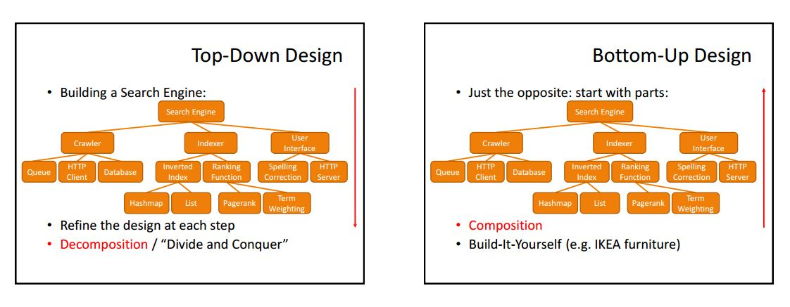

Slide 15
Design Notation and Specification
During design, there needs to be a way in which design decisions are captured
However, natural language often does a poor job of capturing decisions made with respect to a system's structure: as a result, graphical design notations have been developed
Most of these notations are simply variations of the old standby: boxes and arrows
For function-oriented design, a variety of notations exist. We will look at one notation called structure charts/ graphical chart which is used with a design methodology known as structured design.

Slide 16
Structure Charts
A structure chart is a graphical representation of a system's structure; in particular, its modules and their interconnections.
A Structure Chart is a chart which shows the breakdown of a system to its lowest manageable levels.
They are used in structured programming to arrange program modules into a tree. Each module is represented by a box, which contains the module's name.
The tree structure visualizes the relationships between modules.
If A uses B, then an arrow is drawn from A to B.
An arrow is labeled with the parameters received by B as input and the parameters returned by B as output

Slide 17
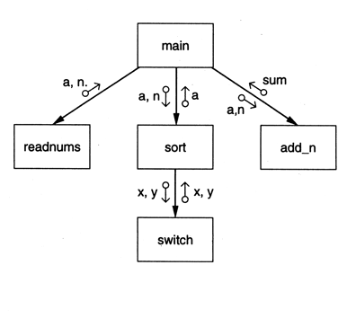
Structure Chart Example

Slide 18
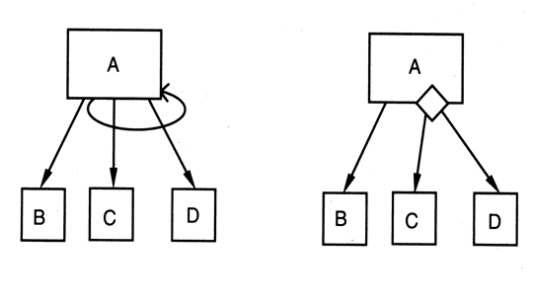
Supporting Iteration and Branching
Notes:
Structure charts can also support the specification of module relationships that involve iteration and/or branching
On the left, A invokes modules C and D in a loop. On the right, A will call either C or D based on some sort of decision.
Note: the presence of a decision is indicated by the diamond, but details of the decision (at least above) are documented elsewhere.

Slide 19
Types of Modules
Input: A module that only produces information that is passed to its superordinate
Output: A module that only receives information from its superordinate for output to a device
Transform: A module that converts data from one format into another format, possibly generating entirely new information.
Coordinator: A module that manages the flow of data to and from different subordinates
Composite: Modules that combine one or more of the above styles are composite modules

Slide 20
Design specification
In addition to capturing the structure of a system with a design notation, a designer must also create a textual specification for each module that appears in the system's structure.

Slide 21
Design specification
A design specification will include
the system structure captured by a design notation
For each module, a specification of its
-interface (input and output data types)
-abstract behavior (what the module does)
-a list of the modules used by this module (this information is also captured by the design notation)
design rationale for each design decision made while creating the above items (its also useful to list decisions that were considered and then rejected along with the reasons why)

Slide 22
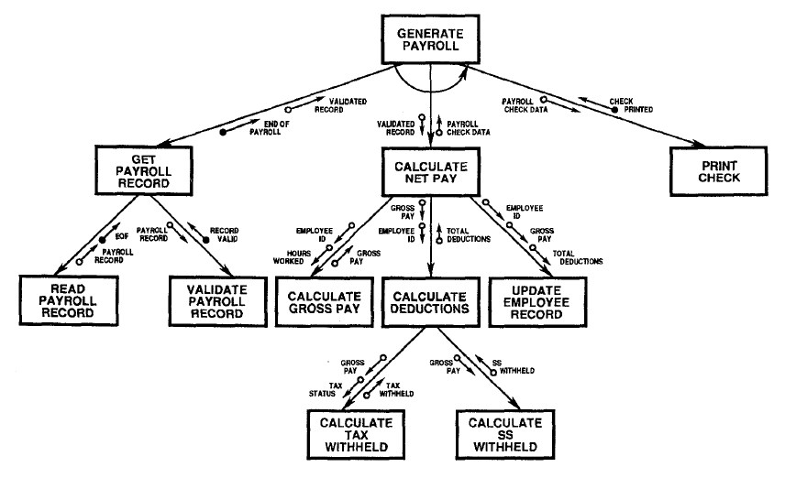
Example of Structure Chart of Payroll System

Slide 23
Tabular Design Notation
Decision tables provide a notation that translates actions and conditions(described in a processing narrative or a use case) into a tabular form.
Steps to formulate decision table:
List all actions that can be associated with a specific procedure (or module)
List all conditions (or decisions made) during execution of the procedure
Associate specific sets of conditions with specific actions, eliminating impossible combinations of conditions; alternatively, develop every possible permutation of conditions
Define rules by indicating what action(s) occurs for a set of conditions

Slide 24
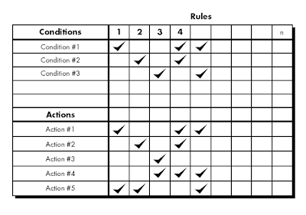
Tabular Design Notation

Slide 25
Tabular Design Notation
To illustrate the use of a decision table, consider the following text from a processing narrative for a public utility billing system
If the customer account is billed using a fixed rate method, a minimum monthly charge is assessed for consumption of less than 100 KWH (kilowatt-hours). Otherwise, computer billing applies a Schedule A rate structure. However, if the account is billed using a variable rate method, a Schedule A rate structure will apply to consumption below 100 KWH, with additional consumption billed according to Schedule B.

Slide 26
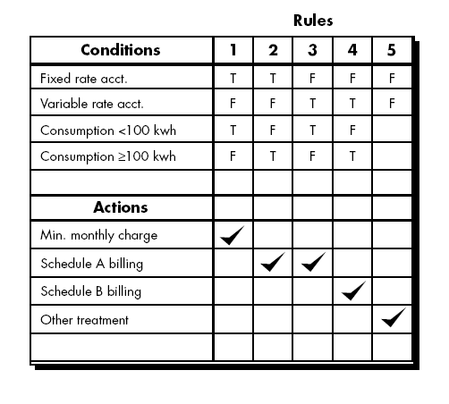
Tabular Design Notation

Slide 27
Tabular Design Notation
Three types of customers are defined: a regular customer, a silver customer, and a gold customer
A regular customer receives normal print rates and delivery.
A silver customer gets an 8 percent discount on all quotes and is placed ahead of all regular customers in the job queue.
A gold customer gets a 15 percent reduction in quoted prices and is placed ahead of both regular and silver customers in the job queue.
A special discount of x percent in addition to other discounts can be applied to any customer’s quote at the discretion of management.

Slide 28
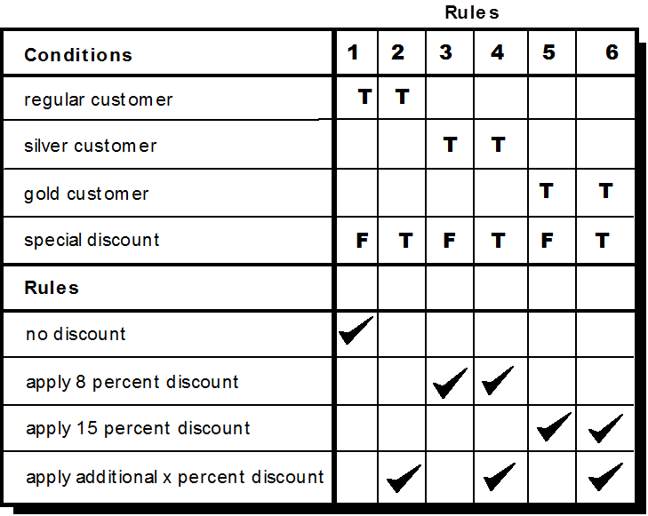
Tabular Design Notation
Actions

